Slide 1
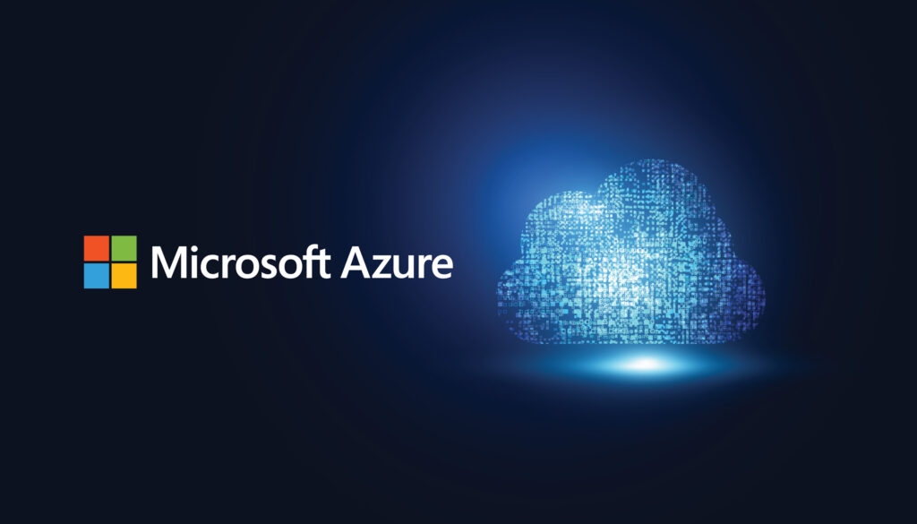

Azure Cloud Data Engineering for BFSI: Scalable ETL and Real-Time Analytics Solution
Prateek Baisla (127232)
Date – 27/02/2025

Slide 2
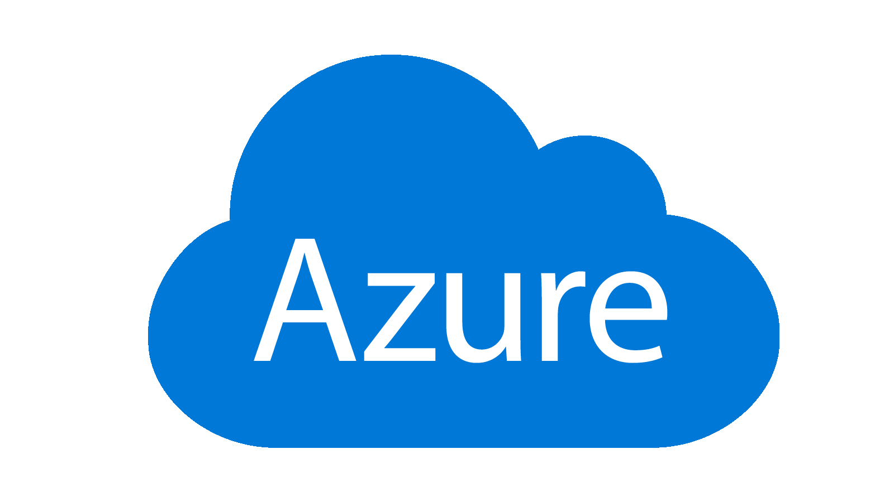
Agenda & Outline of the key sections:
Introduction & Problem Statement
Medallion Architecture
Pipeline Architecture
Data Sources & Ingestion
Data Storage & Management
Data Processing & Transformation
Key Insights & Data Analysis
Results & Business Impact
Scalability & Future Work
Challenges & Lessons Learned

Slide 3
Introduction & Problem Statement
Introduction:
Implement an ETL pipeline using Azure services and Data bricks to process, analyze, and visualize large financial datasets.
Problem Statement:
A fictional financial institution processes millions of transactions daily.
Need for data analysis for:
  Fraud detection
  Risk assessment
  Regulatory compliance
Ingest raw transactional data, transform it, and load it into a secure database for reporting and analysis.
Objectives:
Ingest historical and real-time data from various sources.
Clean, normalize, and transform the data for analysis.
Securely store the transformed data in Azure SQL Database and Azure Cosmos DB.
Process real-time transaction data to trigger alerts for suspicious activities.

Slide 4
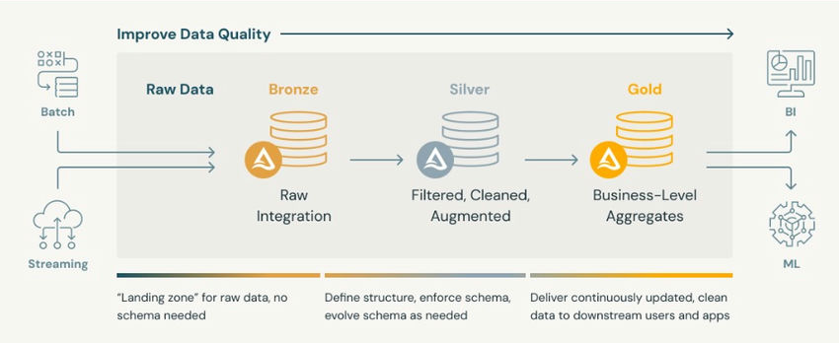
Medallion Architecture

Slide 5
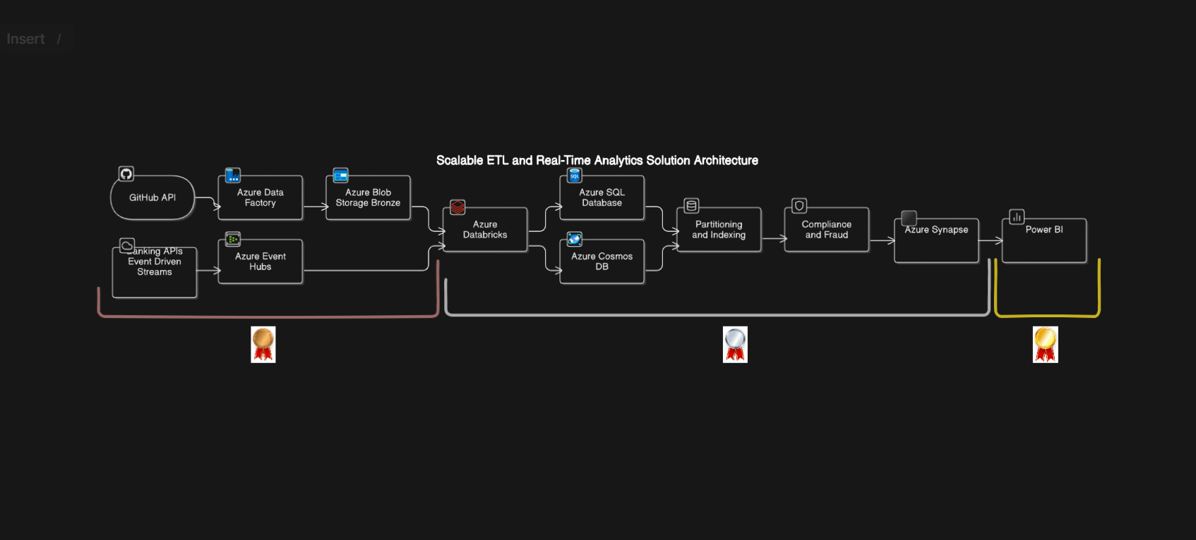
Pipeline Architecture

Slide 6
Data Sources & Ingestion
Data Sources:
Transactional Data: Historical batch processing and real-time streaming analytics.
Customer Data: For customer segmentation and analysis.
Merchant Data: For merchant-related analytics and risk assessment.
Fraud Detection Data: For identifying suspicious activity and enhancing security.
Regulatory Compliance Data: For ensuring adherence to financial regulations.
Ingestion Methods:
Azure Data Factory: Dynamically ingest historical data from GitHub API and HTTP link directly into Azure Blob Storage.
Azure Event Hub: Real-time data streams, created using a Python producer to send data into Event Hub, which is then integrated with Data bricks.

Slide 7
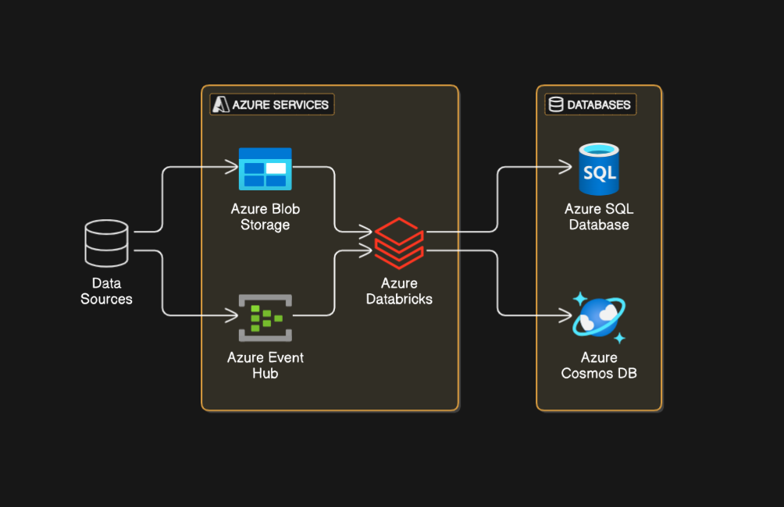
Data Storage & Management
Data Storage & Management
Azure SQL Database:
  For structured data storage and querying.
Azure Cosmos DB:
  For scalable and flexible NoSQL data storage.
Optimization:
  Proper partitioning and query performance optimization.

Slide 8
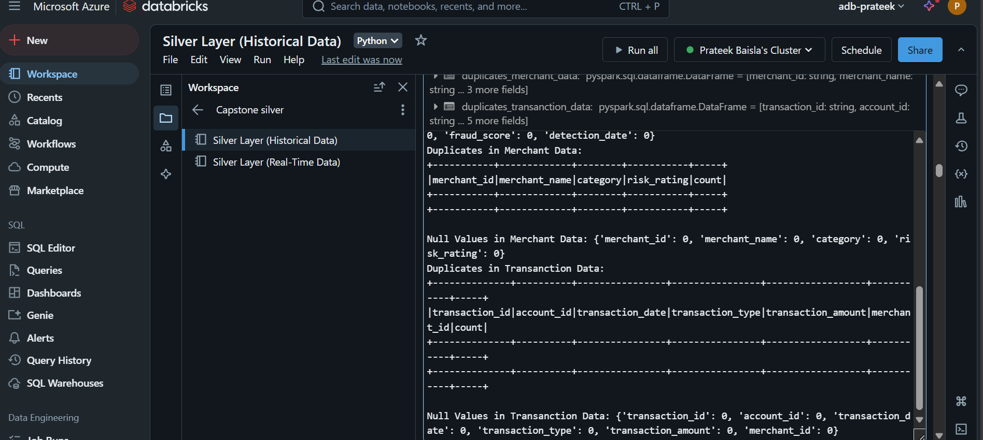
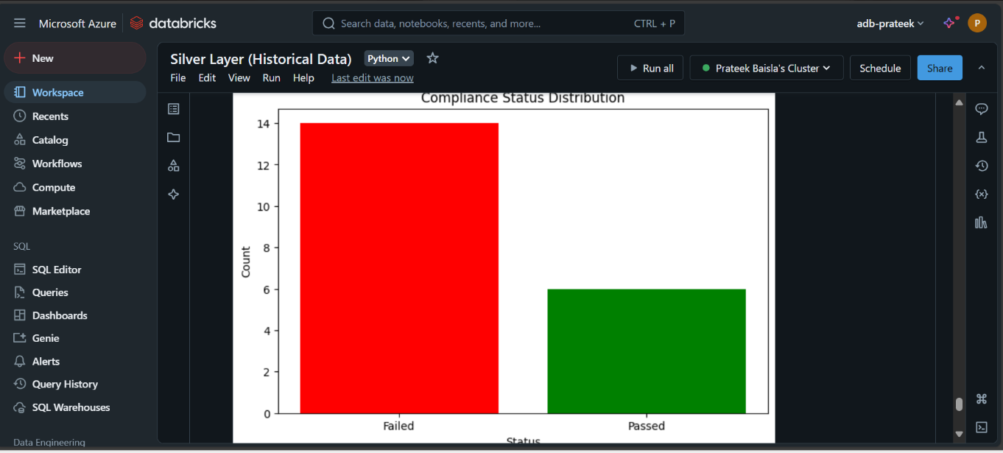
Data Processing & Transformation
Data Cleaning: Correct invalid data, standardize data types, fill missing values.

Slide 9
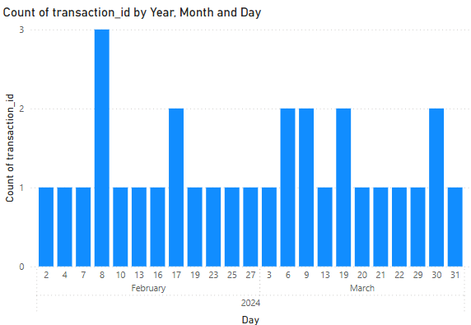
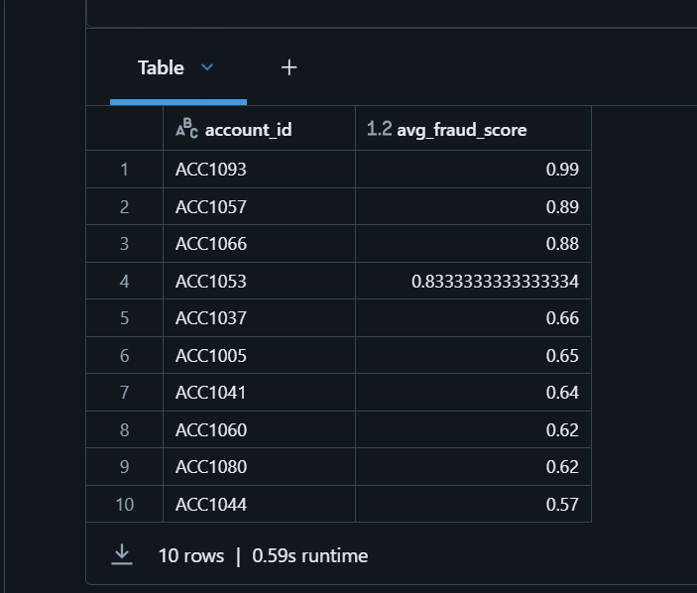
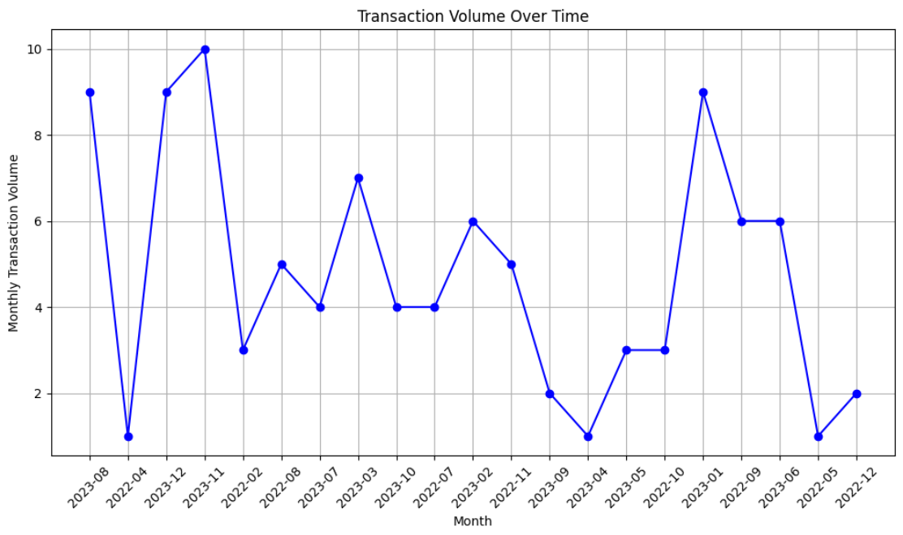
Key Insights & Data Analysis
Transaction Volume Over Time
Fraud Detection Patterns
Fraud Score

Slide 10
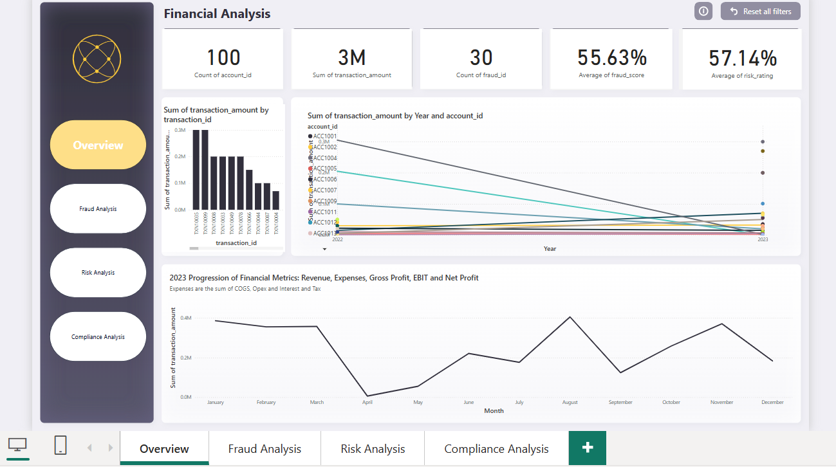

Slide 11
Results & Business Impact
Main Outcomes:
Enhanced Fraud Detection: Early identification of fraudulent transactions reduced financial losses.
Improved Risk Assessment: Better assessment of customer and merchant risk profiles.
Regulatory Compliance: Ensured adherence to financial regulations. Relevance to Business Case:
Fraud detection and risk assessment capabilities directly impact the financial institution's ability to manage risks and maintain regulatory compliance, leading to increased trust and reliability.

Slide 12
Scalability & Future Work
Scalability:
Handling Larger Datasets: Implementing distributed computing and storage solutions to manage growing data volumes.
Optimization: Continuous monitoring and tuning of ETL pipeline performance. Future Enhancements:
Advanced Analytics: Integrating more sophisticated machine learning models for predictive analytics (e.g., customer churn prediction).
Real-Time Data Processing: Expanding real-time capabilities to include more complex event processing and alerting mechanisms.

Slide 13
Challenges & Lessons Learned
Major Challenges:
Handling Large Volumes of Data: Ensuring efficient data processing and storage.
Data Quality and Validation: Maintaining high data quality throughout the ETL process.
Integration of Multiple Azure Services: Seamlessly integrating various Azure services for optimal performance. Lessons Learned:
Best Practices for Data Pipeline Design: Importance of modular design for scalability and maintainability.
Data Validation: Critical role of data validation and error handling to ensure data accuracy.
Leveraging Managed Services: Benefits of using Azure's managed services to simplify infrastructure management and improve scalability.

Slide 14

GITHUB REPO - https://github.com/prateekbaisla/Azure-Cloud-Data-for-BFSI/tree/main
Email
prateekbaisla.work@gmail.com

